Slide 1
IT166 Python for Data Science & Data Analytics For & While Loop
The goal of this class is to turn data into information, and information into insight that leads to do informed decisions.

Slide 2
Outline
The while loop
The for loop

Slide 3

Syntax
No {} , but indentations
: is required
Indentations should be consistent for block statements

Slide 4

Examples
int number = 1;
while (number <= 10) {
System.out.println(number);
number++;
}
Rewrite the above code using Python

Slide 5
Same logic applies
hen = 5;
while hen < 4:
hen = hen * hen
print (hen)
What is wrong?

Slide 6
Logic operators
and, or, not <=> &&, ||, !
int cat = 47, sum = 0;
boolean b = false;
while (cat > 0 || !b) {
cat = 5;
sum = sum + cat;
}
System.out.println( sum );

Slide 7
Translate the code to Python and explain what it does
boolean flag = true;
int counter = 0;
while (flag) {
if (counter > 10)
flag = false;
counter++;
System.out.println(counter);
}

Slide 8
Practice
Use a while loop to print 3 lines of “Hello!”

Slide 9
Problem #1
Define a list that has 5 elements in it.
Use a while loop to empty the list.

Slide 10

Problem #2
Use a while loop to compute:
$$\sum_{x=1}^{20}{x^{2}}$$

Slide 11
Problem #3
Use a while loop to generate a list that has 50 random integers, where each of them is in between [1,100].
Hint: Use the random module: random.randint(1,100)
Use another while loop to find the maximum value of the list.

Slide 12
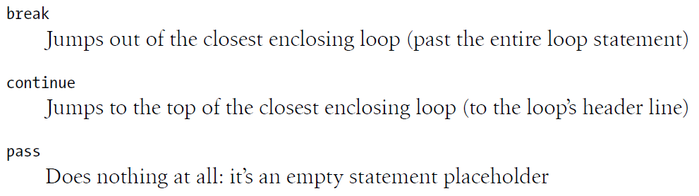
break, continue, pass

Slide 13
break, continue, pass
x = 0
while True:
x += 2
if x <= 10:
continue
print (1,end=“,”)
elif x <= 20:
pass
print (2,end=“,”)
else:
break
print (3,end=“,”)
print x

Slide 14




for loops
The syntax
The beauty of Python’s for loop
range(start,end) is a built-in function which generates a list of numbers from start to end-1 by the default step of 1.
When the start argument is ignored, it starts from 0.
Both the start and the end arguments need to be integers.

Slide 15
Problem #4
Write a for loop to compute:
1+2-3+4-5+…-97+98-99+100
(Every odd number that is greater than 1 is negative.)

Slide 16
Problem #5
Use a for loop to generate a list that has 50 random integers, where each of them is in between [1,100].
Compute the absolute differences in between the nth number and the n+1th number and save all the differences into a separate list.

Slide 17
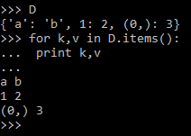
Looping through a dictionary

Slide 18
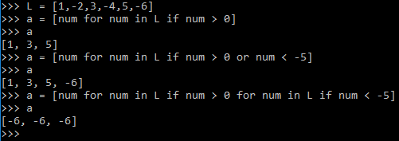
List comprehension examples

